Slide 1
Task 4 : Setup and Use a Firewall on Windows/Linux
Windows Firewall Configuration Task Summary :
Tool Used : Windows Defender Firewall (Advanced Settings)
Objective : Block port 23 (Telnet) and allow port 22 (SSH)
Steps Followed :
Opened Windows Defender Firewall → Advanced Settings.
Created new Inbound Rule to block TCP port 23.
Tested using telnet localhost 23 → confirmed block.
Created new Inbound Rule to allow TCP port 22 (SSH).
Deleted the test block rule to restore system to original state.

Slide 2
Summary : How Firewall Filters Traffic
Firewalls filter traffic based on rules that allow or block network packets.
They work on :
Inbound rules : Control traffic coming into your system.
Outbound rules : Control traffic going out from your system.
Rules can be defined by :
Port numbers (e.g., block 23, allow 22)
Protocols (TCP/UDP)
Application names
IP addresses or ranges
A firewall acts as a security gatekeeper — only allowing traffic that matches allowed rules.

Slide 3
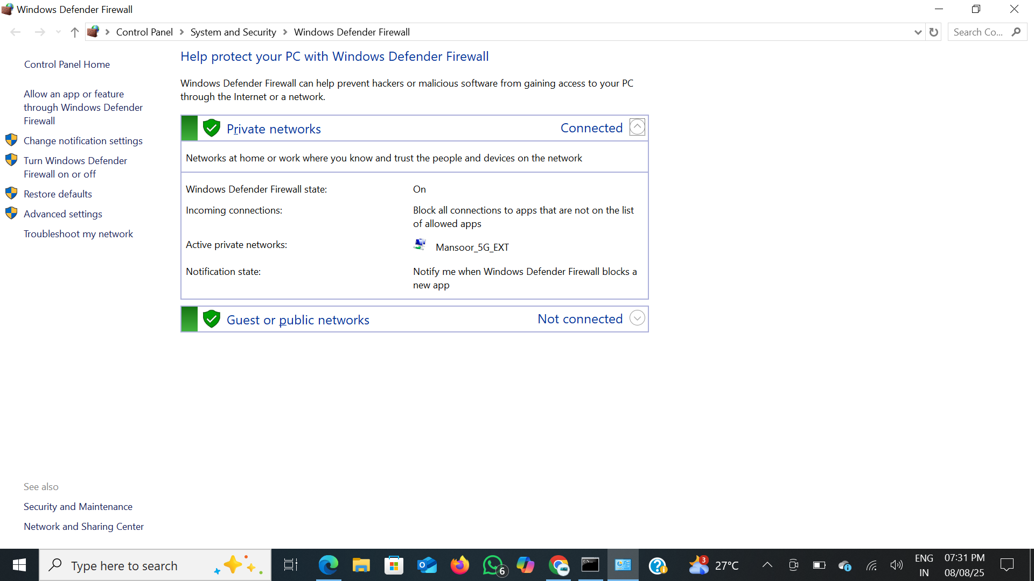
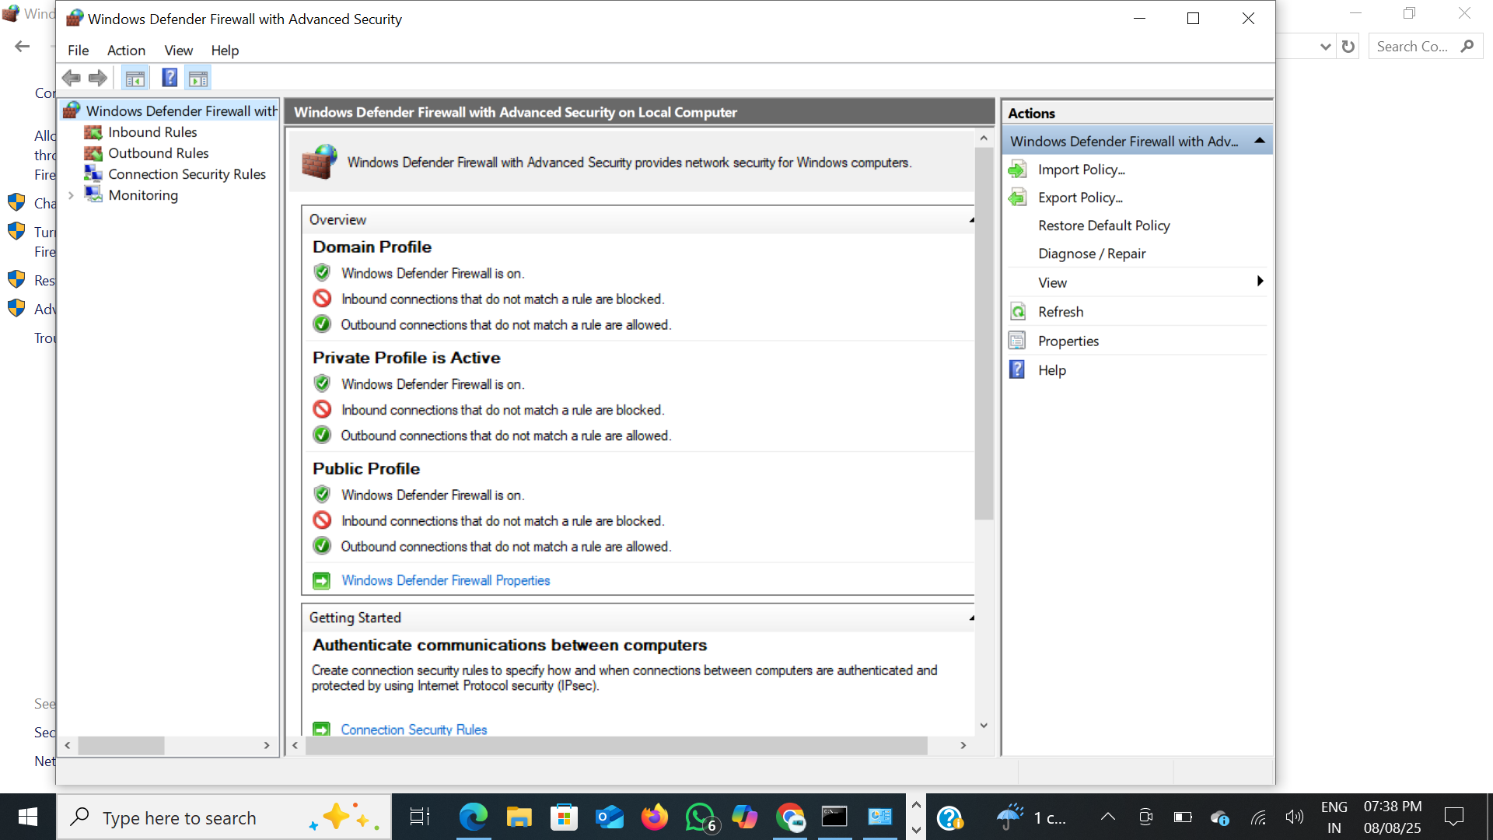

Slide 4
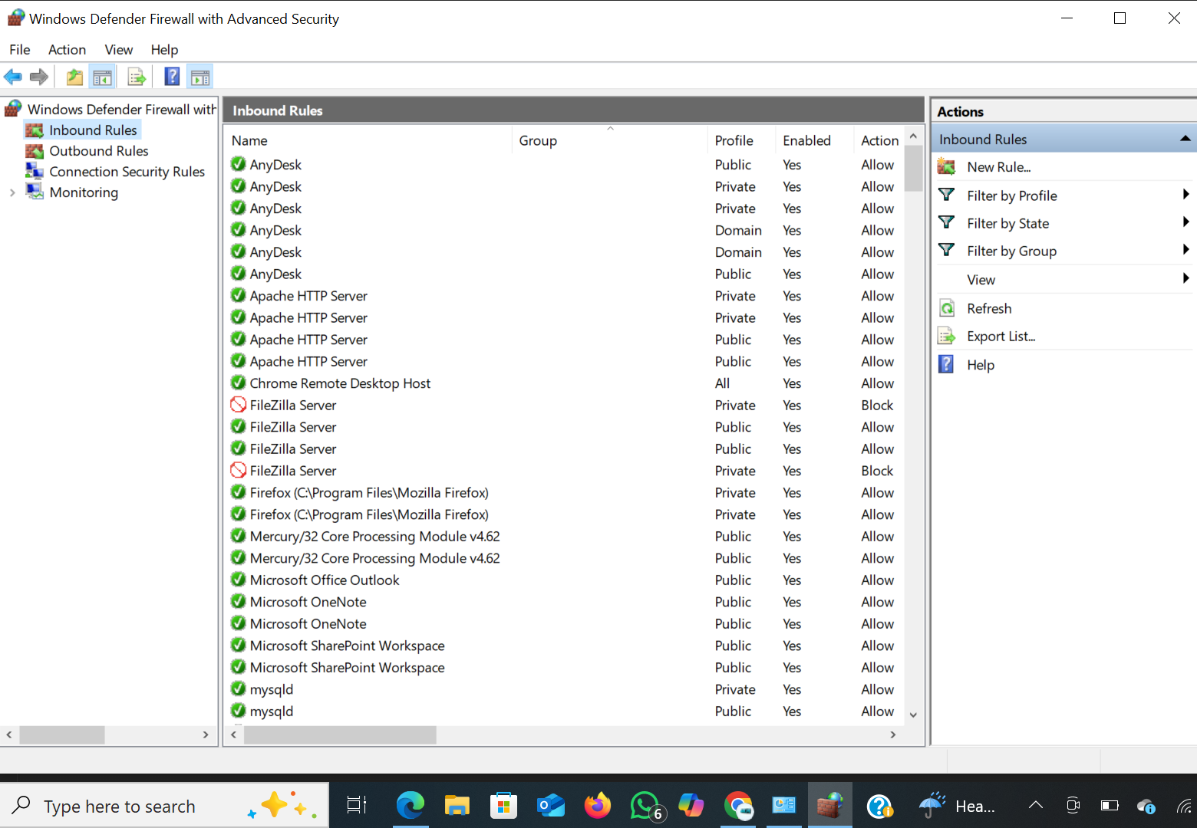

Slide 5
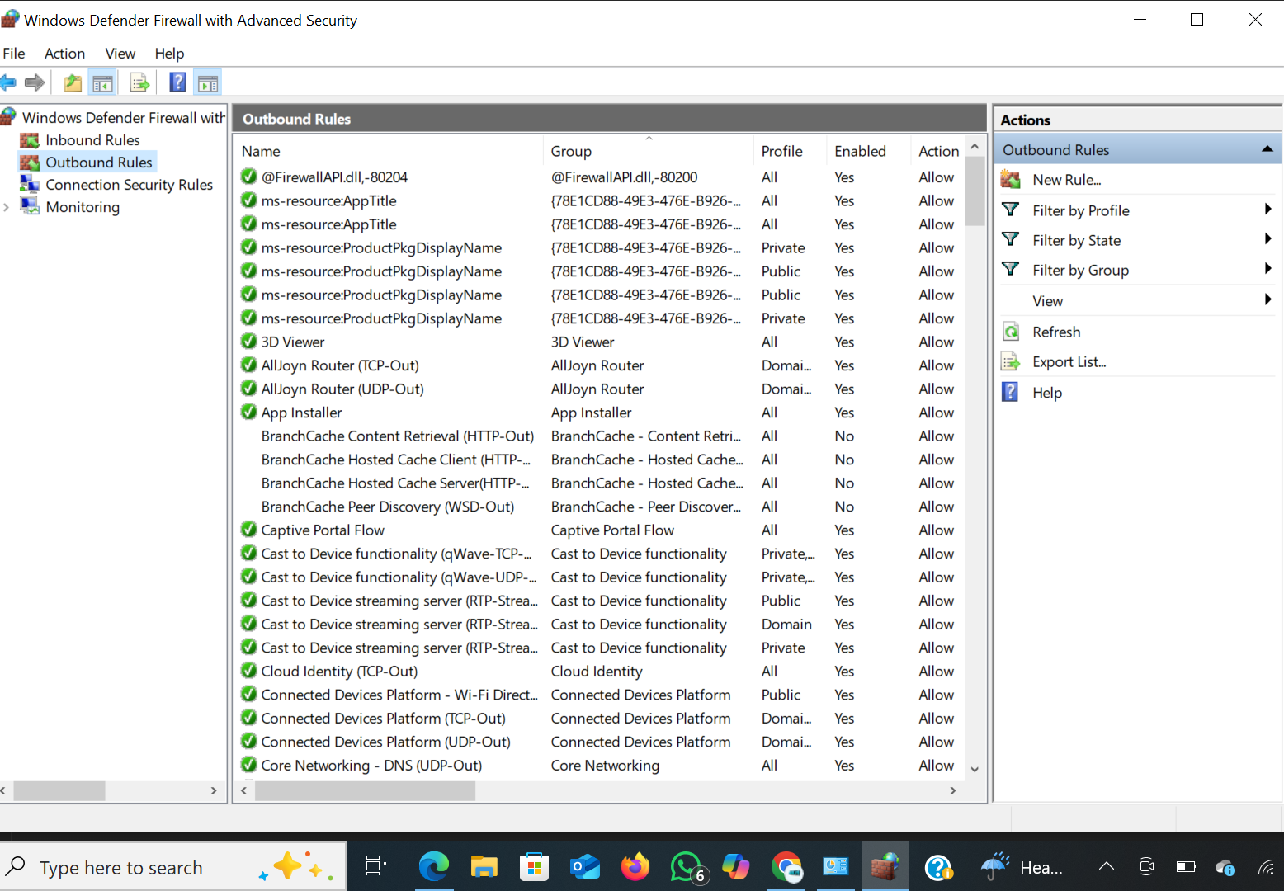

Slide 6
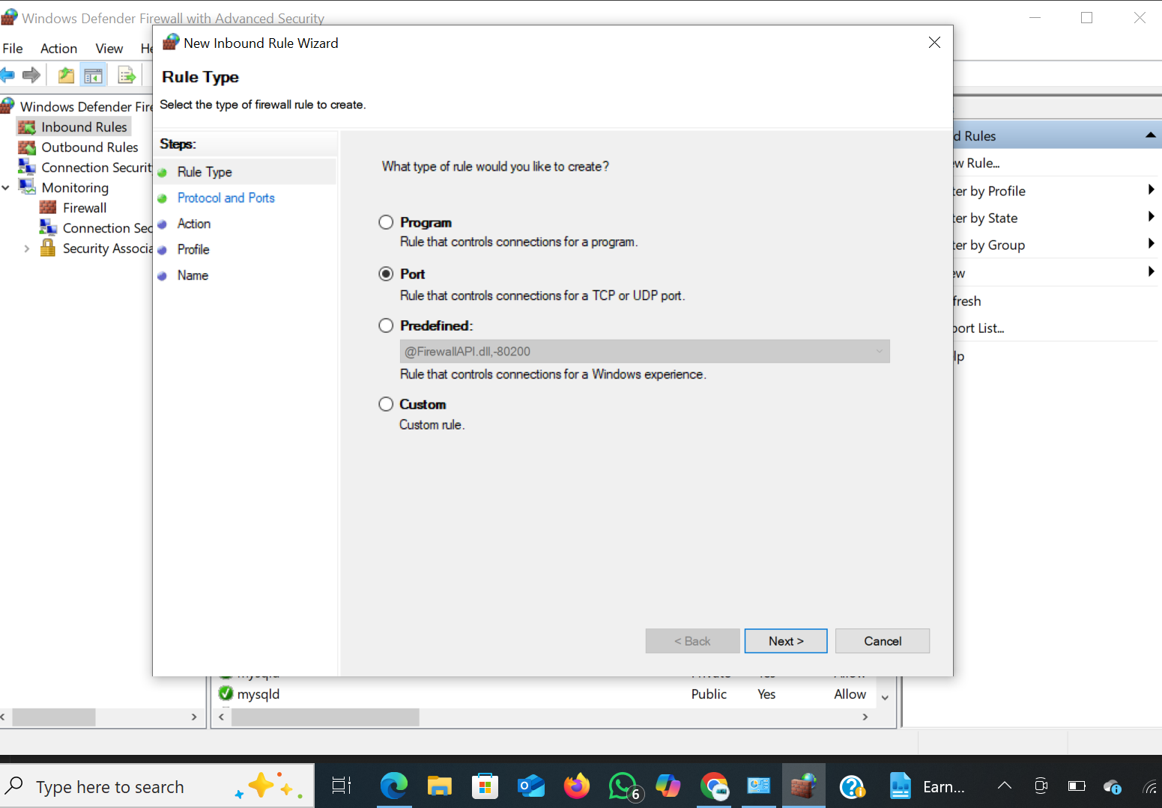

Slide 7
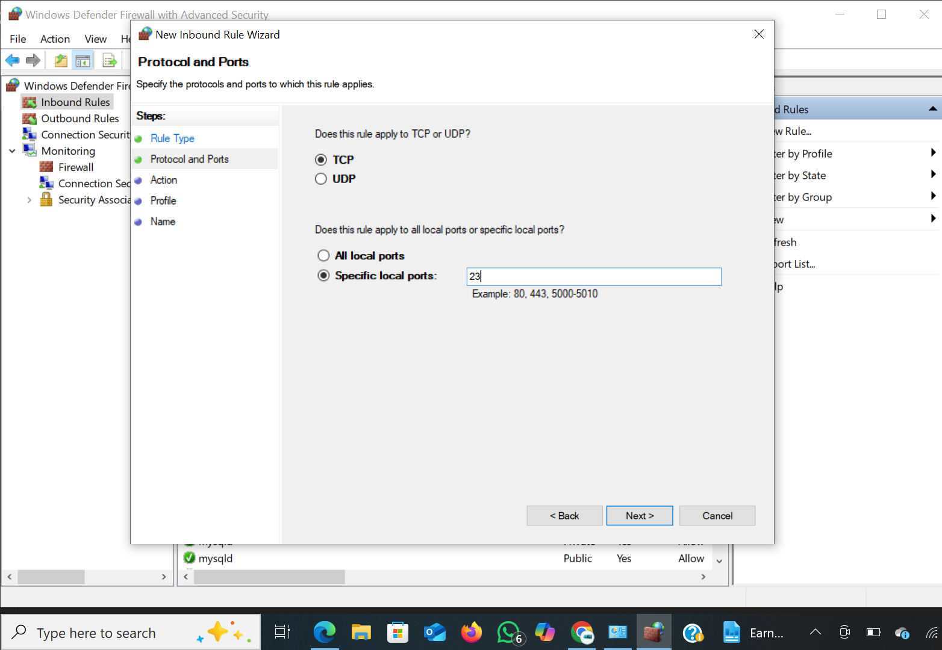

Slide 8
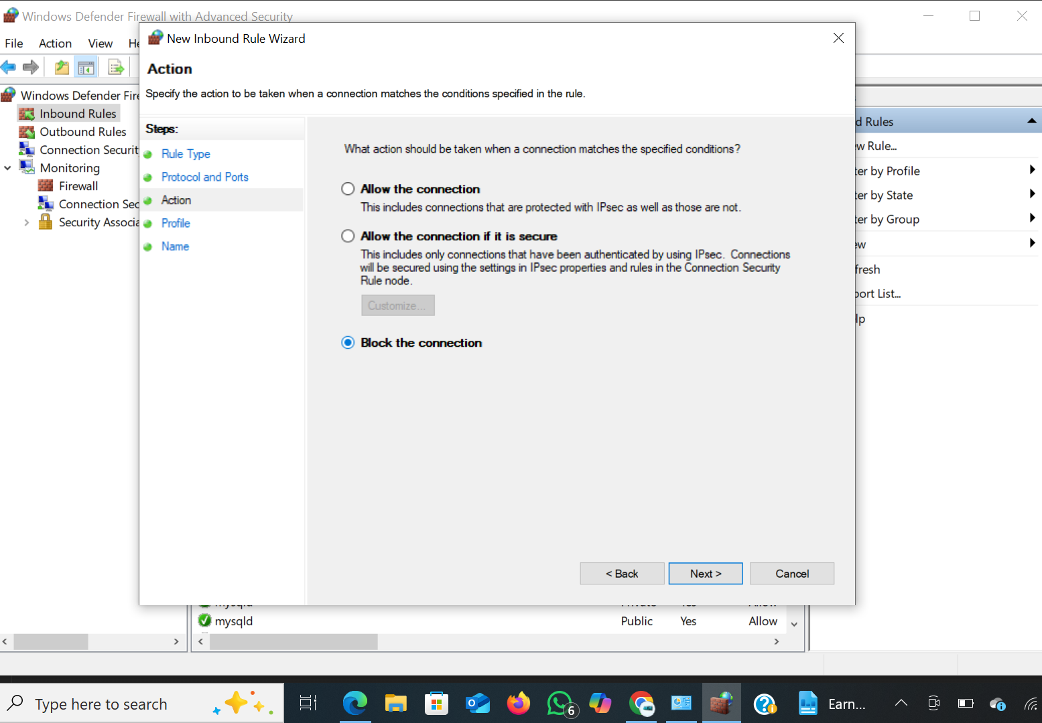

Slide 9
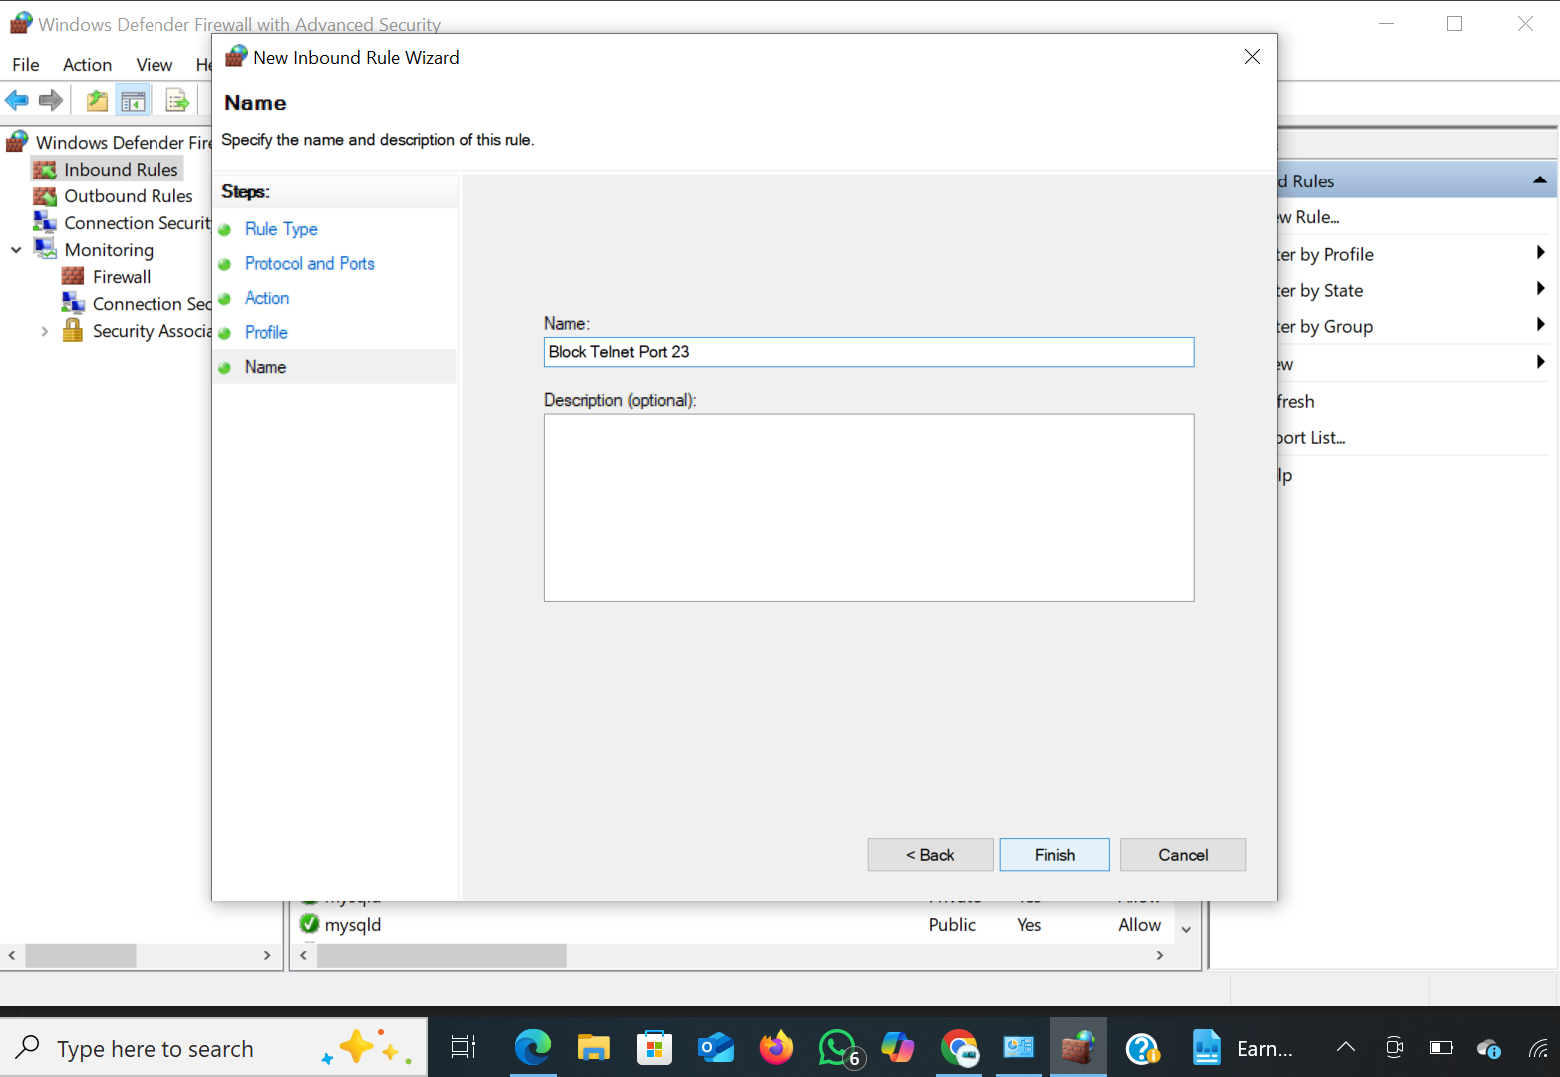

Slide 10
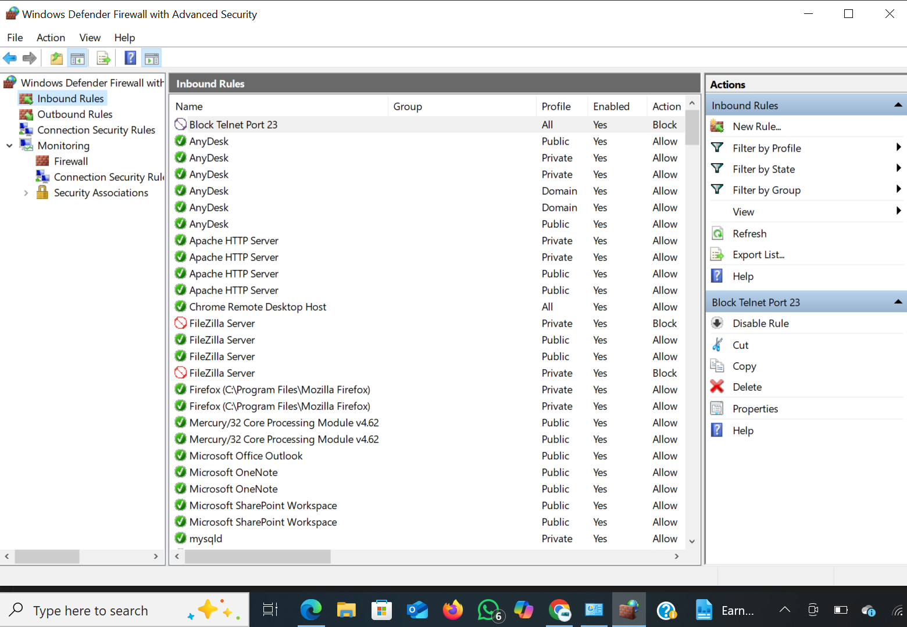

Slide 11
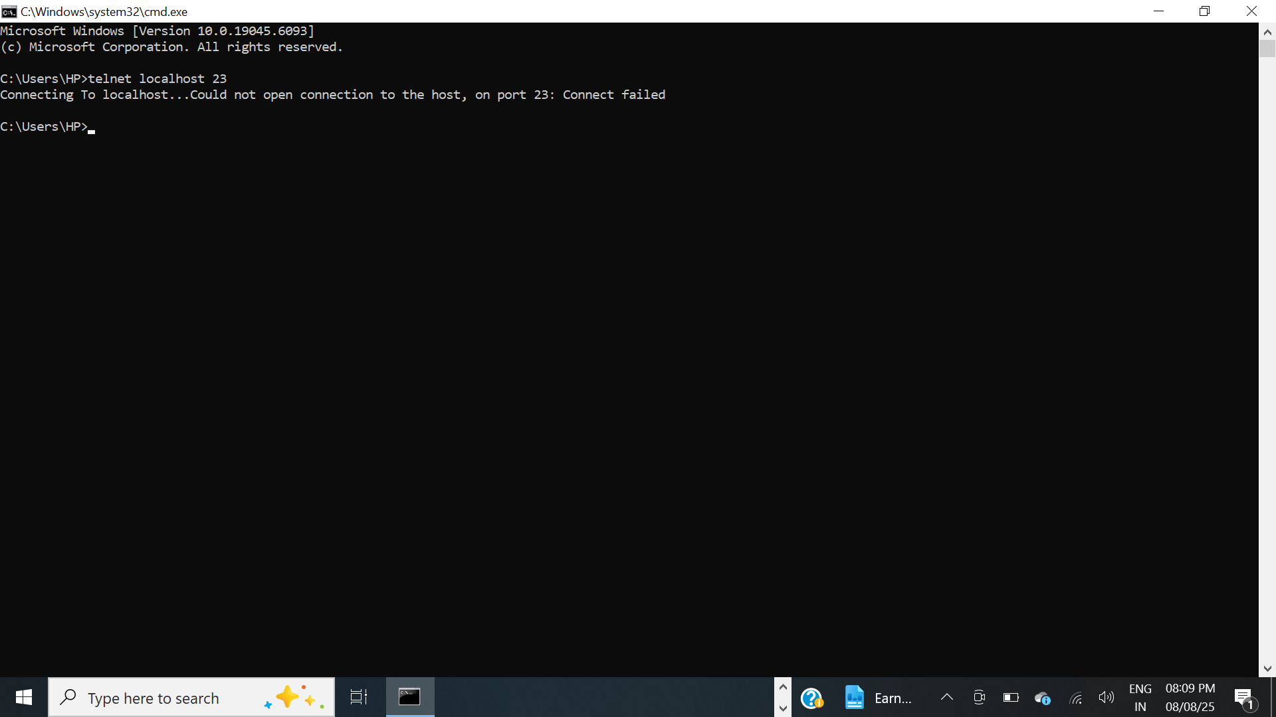

Slide 12
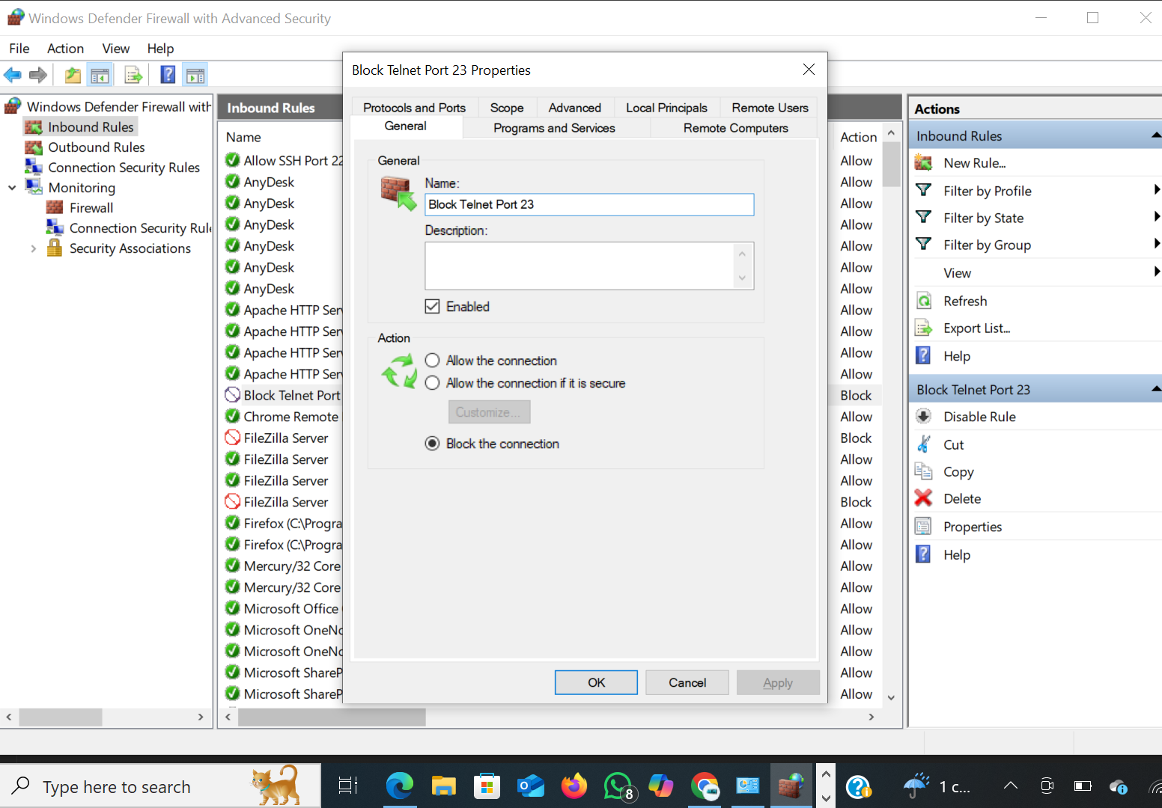

Slide 13
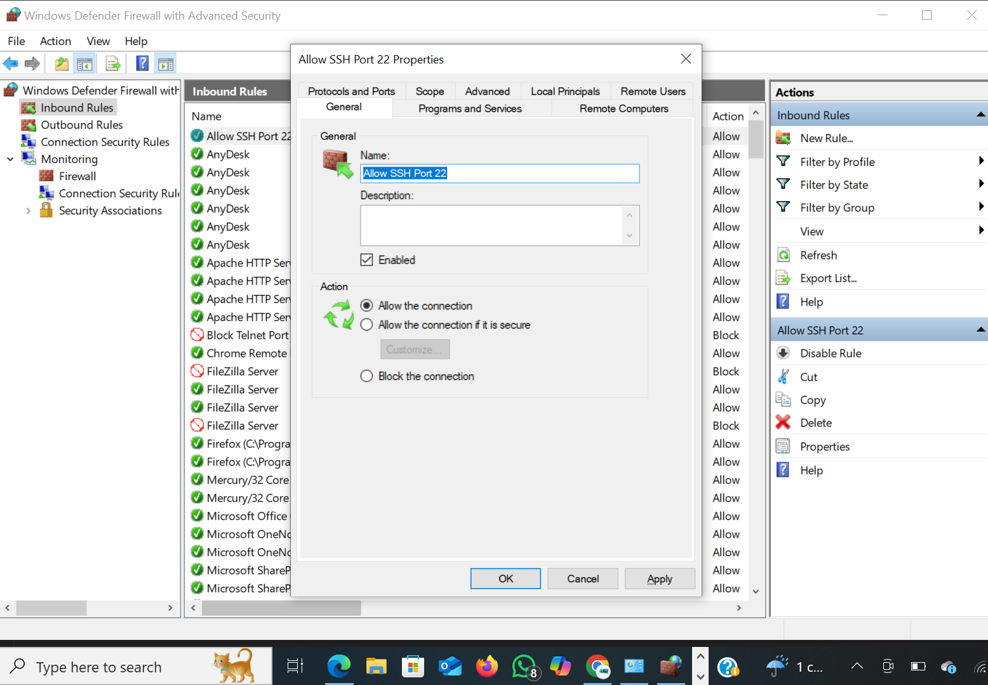

Slide 14
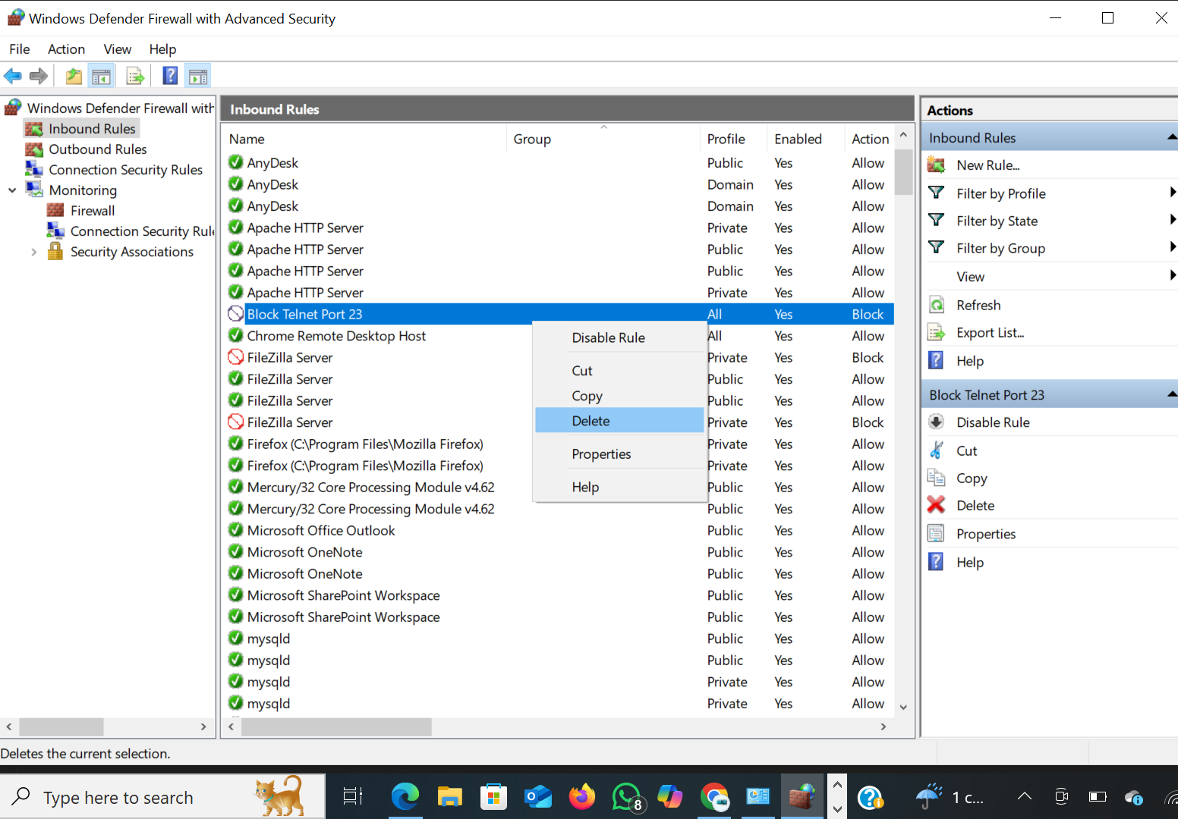

Slide 15
Conclusion :
This task demonstrated the practical use of a firewall to control network traffic based on defined rules. By configuring Windows Defender Firewall, I successfully blocked inbound traffic on Telnet port 23 and verified the rule through testing. I also created an allow rule for SSH (port 22), simulating real-world scenarios where selective access is crucial.
This hands-on experience improved my understanding of how firewalls filter traffic, how rules are created and applied, and how to test their effectiveness. Such skills are essential for maintaining secure systems and defending against unauthorized access.

